Slide 1
Azure BrushUp

Slide 2






Slide 3
Azure AD – Now called Microsoft Entra ID
Identity and Access Management Service
User and Group Management
Licenses
App Registrations
Self Service Password Reset

Slide 4
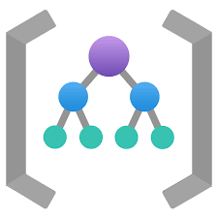


User 1
User 2
User 3
User 4
User 5
Group 1
Group 2
Group 3
Group 4
Group 5
Subscription 1
RG 1
RG 2
RG 3
Subscription 2
RG 4
RG 5
Management Group
Subscription 1
RG 1
RG 2
Subscription 2
RG 4
RG 3
RG 5

Slide 5
User, Group and RBAC
1. Create a User and Group.
2. Add User to the Group
3. Create a Resource Group
4. Grant the group, reader access on the RG

Slide 6
Azure Virtual Machines
IaaS Cloud Services
Planning Checklist
Start with VNet
Name of the VM
Decide the location
Determine the size
Storage for the VM
Operating System

Slide 7
High Availability
Availability Sets - Rack
Availability Zones - Datacenter
Virtual Machine Scale Set – Auto Scaling

Slide 8
Storage
Massively scalable object store – Blob Storage
File system service for the cloud – File Share
Messaging Store – Queue Storage
NoSQL store – Tables
Types:
General Purpose v2
General Purpose v1
Blob Storage

Slide 9

Redundancy
LRS
ZRS
GRS
RA-GRS
GZRS
RA-GZRS

Slide 10
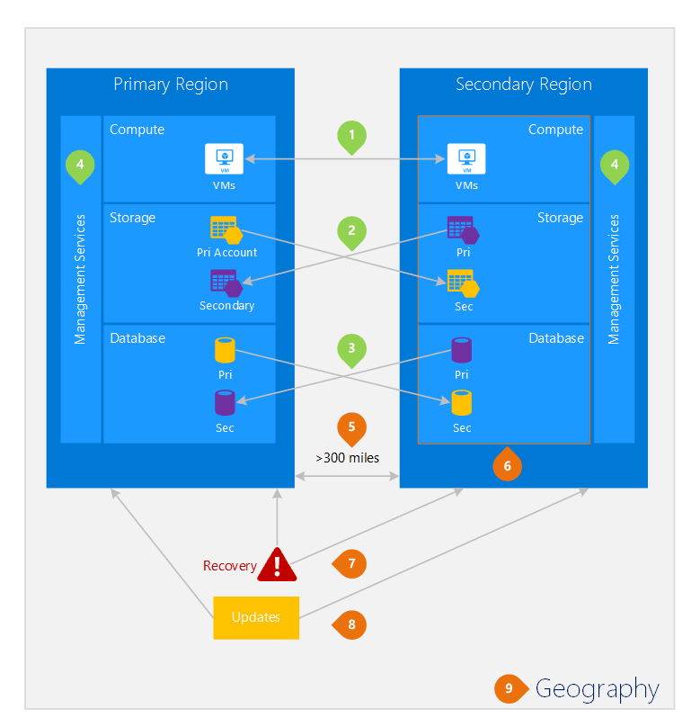

Slide 11
Virtual Network
Representation of your own network in the cloud.
CIDR – Classless Interdomain Routing
Address Space: 10.0.0.0/16
Subnet: VNet segmented into one or more subnets
Service Endpoint – Extends virtual networks to service

Slide 12
IP Addressing
Public IP
Private IP

Slide 13
Network Security Group
A service to limit the network traffic to resources in a virtual network
Inbound Rules
Outbound Rules

Slide 14



















Load Balancer
High availability and network performance to your applications
OSI Layer 4

Slide 15

























Slide 16
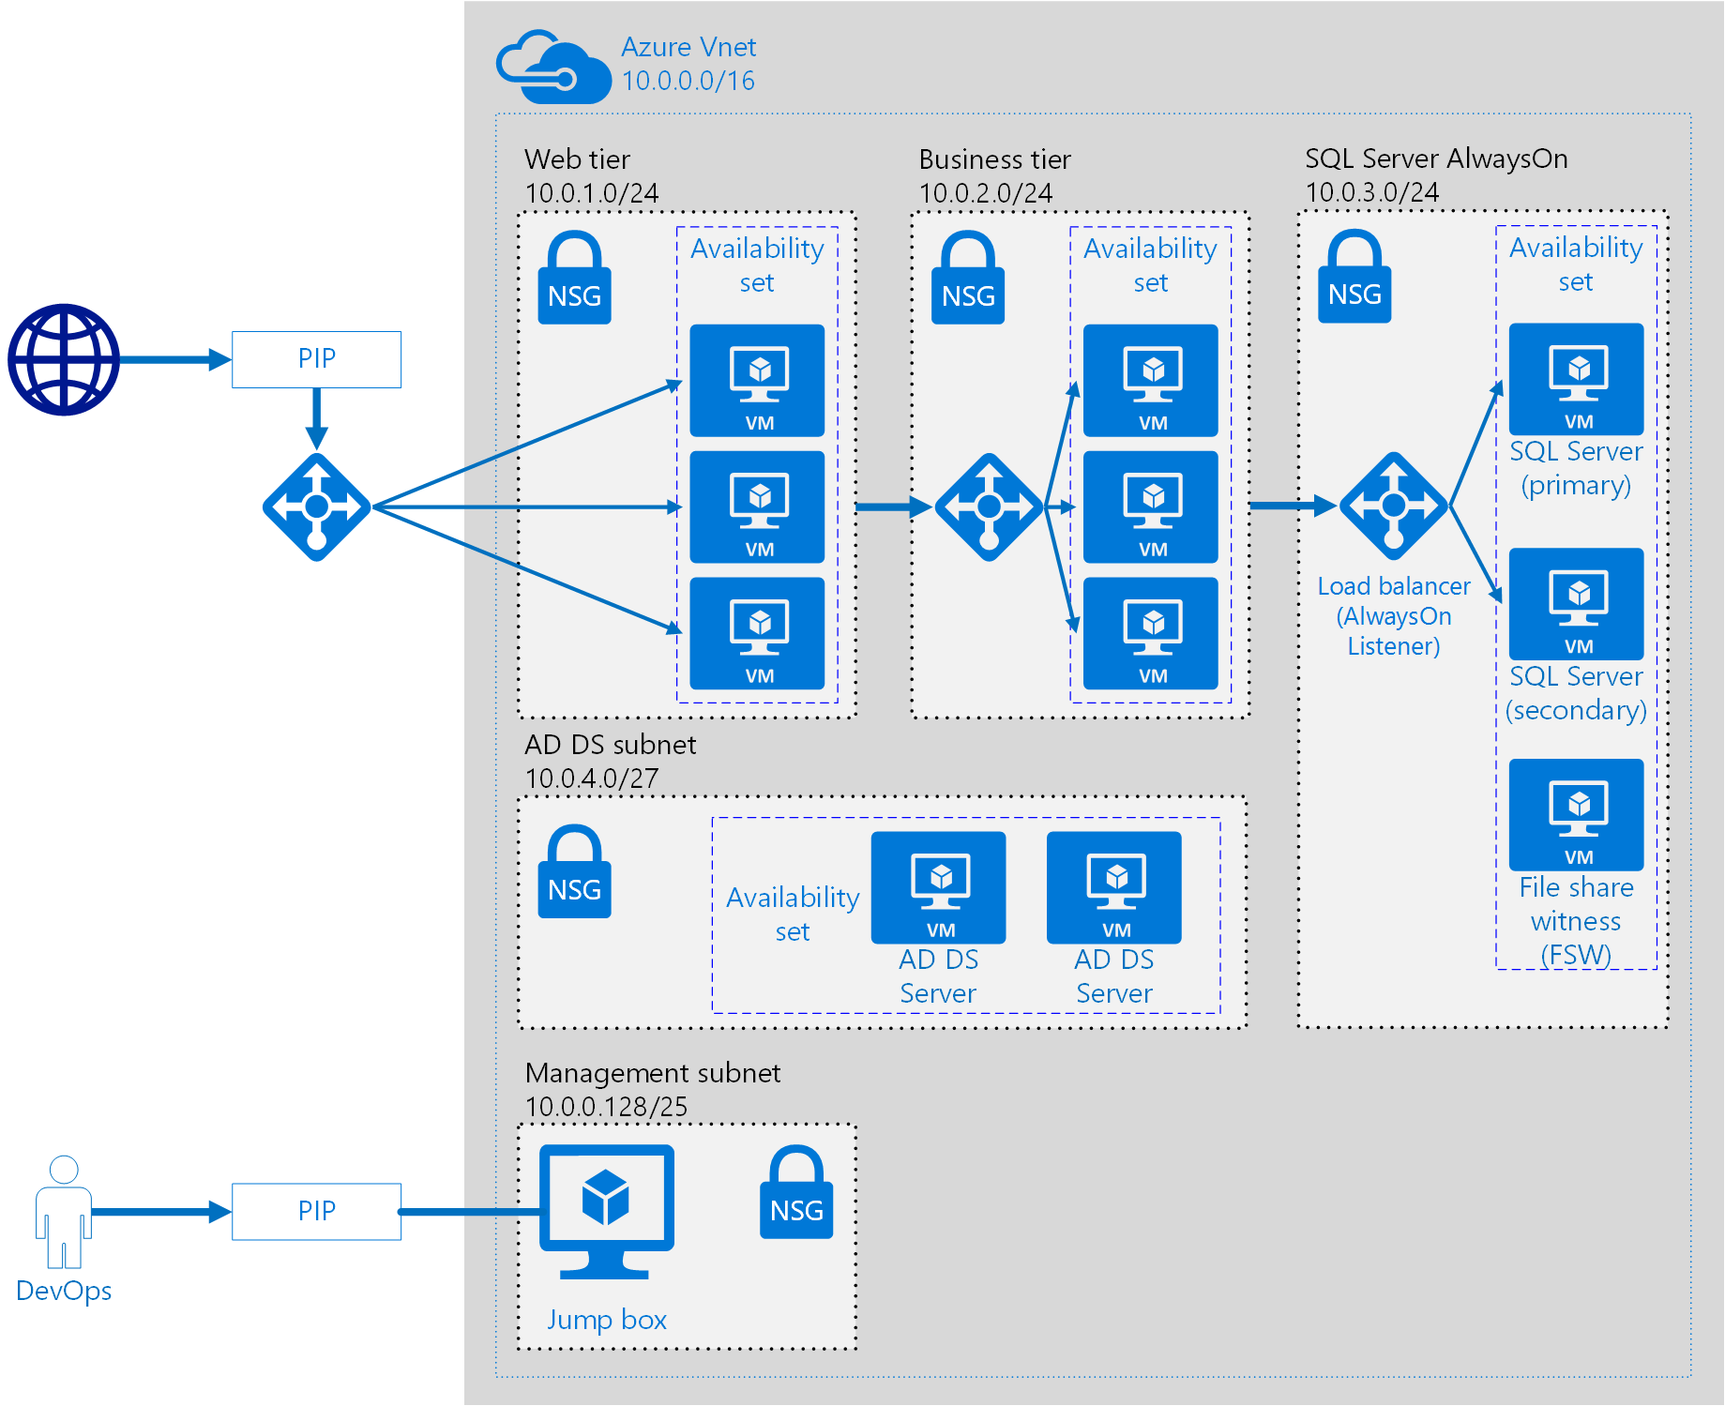





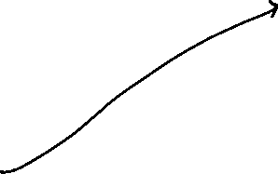

















Slide 17
Azure App Service
Microsoft PaaS offering to deploy, design and scale web apps
App Service
App Service Plan

